Slide 2
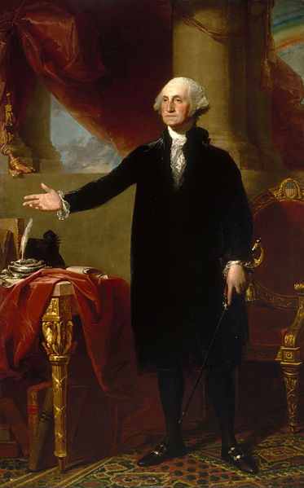
1st - George Washington 1789-1797
Born in Virginia in 1732
He was a Revolutionary War hero.
He was very tall. He stood at 6ft., 2in. and wore size 13 shoes!
He was the only President who didn’t live in the White House.
He didn’t want to be paid for his job as President because he was very wealthy.

Slide 3
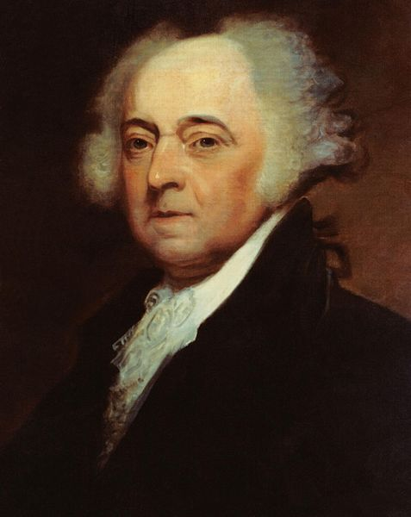
2nd - John Adams 1797-1801
Born in Massachusetts in 1735
He was Vice President for George Washington.
He helped write the Constitution.
He was the 1st President to live in the White House.
He was a hard worker but had a temper and yelled very loud.

Slide 4
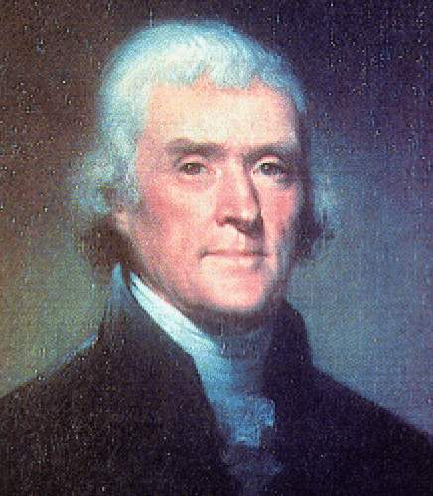
3rd - Thomas Jefferson 1801-1809
Born in Virginia in 1743
He wrote most of the Declaration of Independence.
He is on the nickel and $2.00 bill.
He was the Vice President for John Adams.
He spoke 6 languages!
He played violin 3 hours a day.

Slide 5
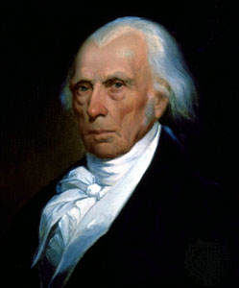
4th - James Madison 1809-1817
Born in Virginia in 1751
He is the father of the Constitution.
He is the smallest President at 5ft. 4 in. and weighed 100 pounds.
He was president when the White House burned down during the War of 1812.

Slide 6
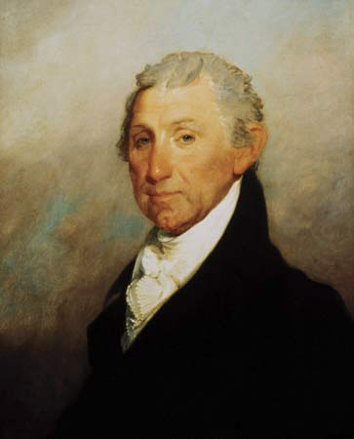
5th - James Monroe 1817-1825
Born in Virginia in 1758
He studied law with Thomas Jefferson.
He was the 1st President to display his own hair and not a wig in public.
He was a very popular President.
No one ran against him in his 2nd term election.

Slide 7
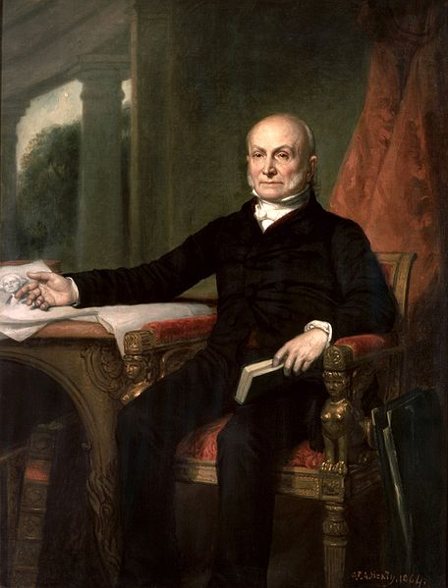
6th - John Quincy Adams 1825-1829
Born in Massachusetts in 1767
He was the son of John Adams, 2nd President.
He owned an alligator for a pet.
He swam in the cold Potomac River every morning.
He was the 1st President to have a picture taken from a camera.

Slide 8
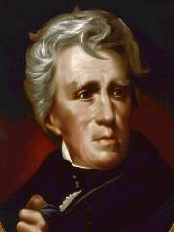
7th - Andrew Jackson 1829-1837
Born in South Carolina in 1767
He was the 1st President to ride on a train.
He was the 1st President to have running water in the White House.
He fought in the Revolutionary War at age 13.

Slide 9
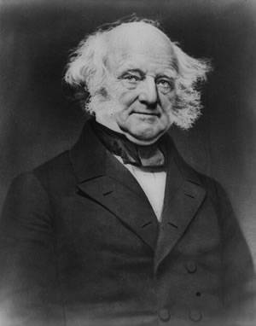
8th - Martin Van Buren 1837-1841
Born in New York in 1782
He was the 1st President born as an American Citizen.
He spoke Dutch at home.
He was the Secretary of State for Andrew Jackson.
He was a very friendly President.

Slide 10
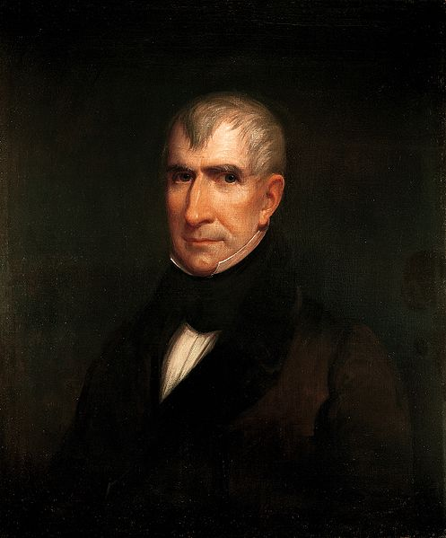
9th - William Henry Harrison 1841
Born in Virginia in 1773
He gave the longest inauguration speech in cold weather with no hat or gloves on. He got pneumonia and died 1 month later.
He had 10 children.

Slide 11
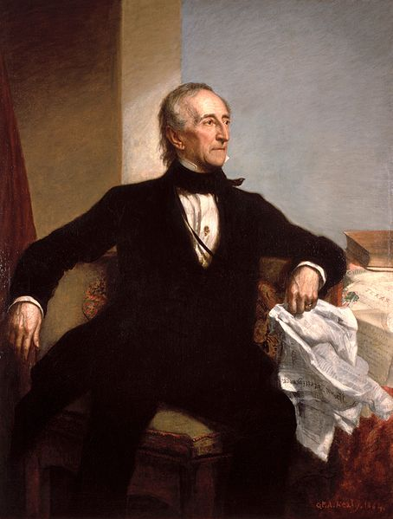
10th – John Tyler 1841-1845
Born in Virginia in 1790
He was Vice President for William Harrison and took over as President when he died.
He loved kids and had 15 children of his own.
He liked to play the fiddle.

Slide 12
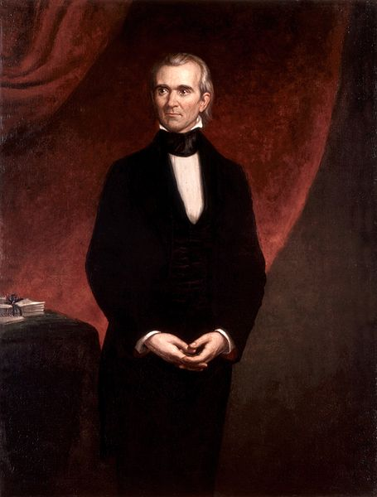
11th – James K. Polk 1845-1849
Born in North Carolina in 1795
He was the 1st President to have Thanksgiving at the White House.
He gave boring parties at the White House. There was no dancing, no music, or no alcohol allowed.

Slide 13
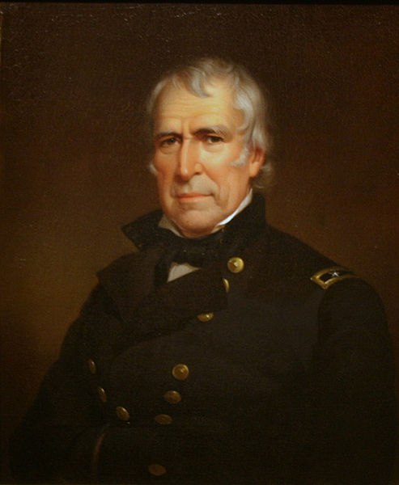
12th – Zachary Taylor 1849-1850
Born in Virginia in 1784
He died after 16 months in Office from a digestive problem.
He owned over 100 slaves on his estate.

Slide 14
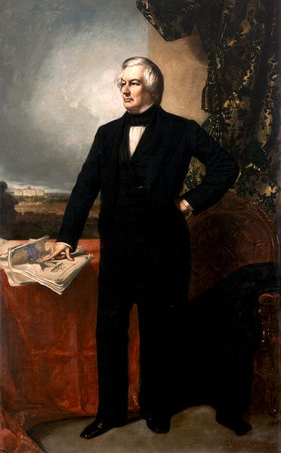
13th – Millard Fillmore 1850-1853
Born in New York in 1800
He was Vice President for Zachary Taylor and took Office when he died.
He was the 1st President to have a stove and bathtub in the White House.
He was the 1st President to have a library in the White House.

Slide 15
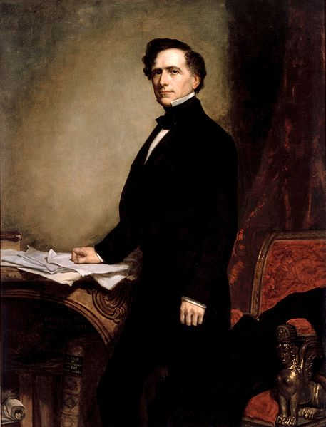
14th - Franklin Pierce 1853-1857
Born in New Hampshire in 1804
He installed heat in the White House.
He was the 1st President to have a Christmas tree at the White House.
He made all his speeches by memory.

Slide 16
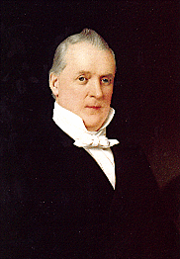
15th – James Buchanan 1857-1861
Born in Pennsylvania in 1791
He is the only President that was not married.
He was nearsighted in one eye and farsighted in the other eye.
He tried to stop the Civil War and made many enemies from this.

Slide 17
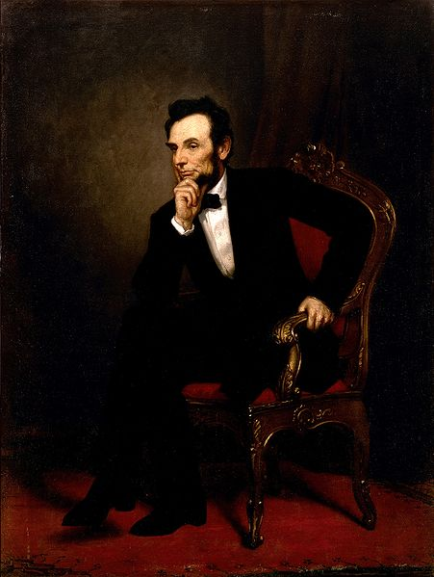
16th – Abraham Lincoln 1861-1865
Born in Kentucky in 1809
He abolished slavery.
He is the tallest President. He stood at 6ft, 4in.
He was the 1st President to be assassinated.
He taught himself how to read and write.
He was the 1st President to have a beard.

Slide 18
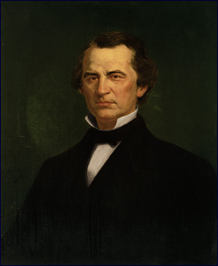
17th – Andrew Johnson 1865-1869
Born in North Carolina in 1808
He was Vice President for Abraham Lincoln and took over Office when he died.
He never attended school.
He liked to sew and opened his own tailor shop.
He was the 1st President to be impeached.

Slide 19
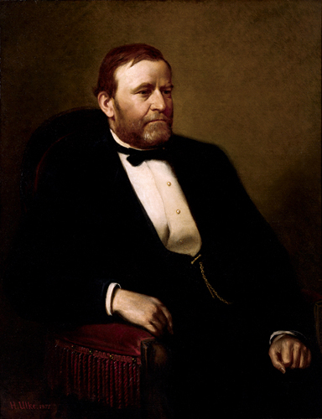
18th – Ulysses S. Grant 1869-1877
Born in Ohio in 1822
He loved horses.
He served in the Mexican-American War.
He ended the Civil War.
He is on the $50.00 bill.
His wife, Julia, added closets to the White House.

Slide 20
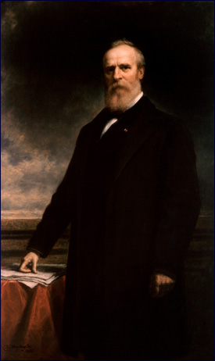
19th – Rutherford B. Hayes 1877-1881
Born in Ohio in 1822
He was the 1st President to use a telephone.
He had 8 children.
He was very strict and was always serious.

Slide 21
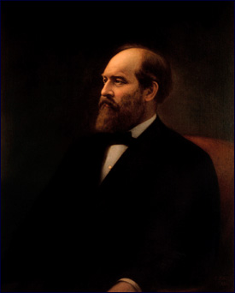
20th – James A. Garfield 1881
Born in Ohio in 1831
He was the 1st left handed President.
He was assassinated in 1881, after 19 days as President.

Slide 22
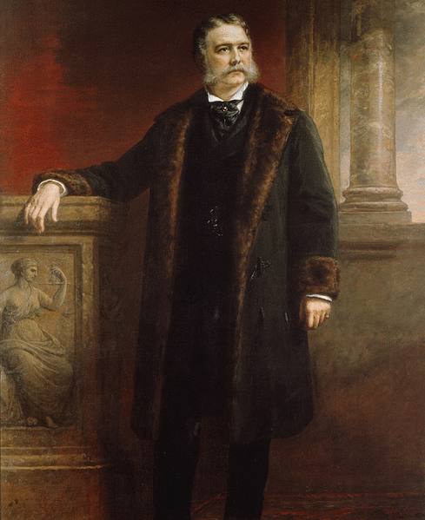
21st – Chester A. Arthur 1881-1885
Born in Vermont in 1830
He took over Office as President when Garfield died.
He was a New York Lawyer.
He was known as a very good fisherman.

Slide 23
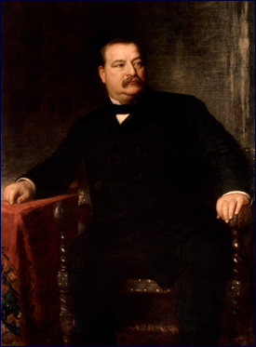
22nd – Grover Cleveland 1885-1889
Born in New Jersey in 1837
He was the only President married in the White House.
He is also the 24th President.
He declared Labor Day as a Holiday.

Slide 24
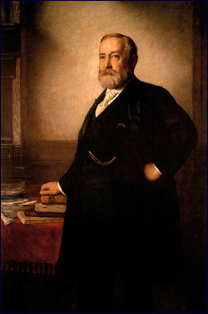
23rd - Benjamin Harrison 1889-1893
Born in Ohio in 1833
His grandfather was the 9th President.
He was the 1st President to have electricity in the White House.
He wore gloves all the time because he was afraid of germs.

Slide 25
24th - Grover Cleveland 1893-1897
He was also the 22nd President.
He is the only President to serve two nonconsecutive terms.

Slide 26
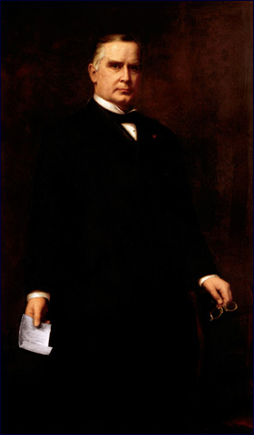
25th – William McKinley 1897-1901
Born in Ohio in 1843
He was assassinated in 1901, at age 58.
He was one of our best, loved Presidents.
He was very kind and considerate.

Slide 27
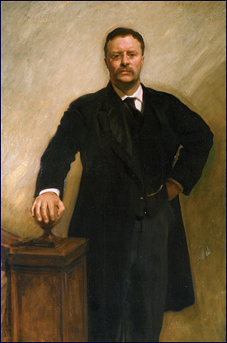
26th – Theodore Roosevelt 1901-1909
Born in New York in 1858
He loved to read. He read 2-3 books a day!
He was Vice President to McKinley and took over Office when he died.
“Teddy Bears” were named after him.
He won a Nobel Peace Prize in 1906.
He was the 1st President to fly in an airplane.

Slide 28
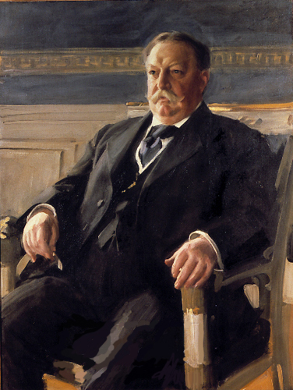
27th – William Howard Taft 1909-1913
Born in Ohio in 1857
He is the largest President, weighing 332 pounds.
He loved to sleep and sometimes fell asleep in meetings.
He was very smart.

Slide 29
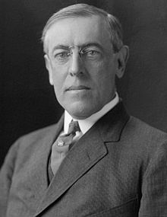
28th – Woodrow Wilson 1913-1921
Born in Virginia in 1856
He suffered a stroke while in office. His wife, Edith, took over his Presidential duties.
He won a Nobel Peace Prize in 1919.

Slide 30
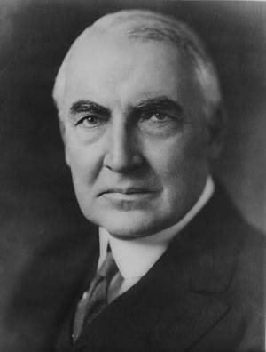
29th – Warren G. Harding 1921-1923
Born in Ohio in 1865
It is said that Harding was our “Worst President”
He joined the Ku Klux Klan, gambled away the White House China, and spent his days playing golf instead of working.
He died of an “unknown cause” while coming back from a trip in Alaska.

Slide 31
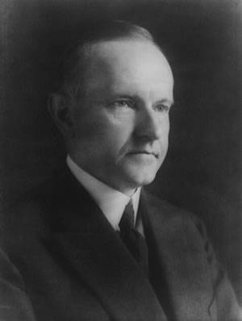
30th - Calvin Coolidge 1923-1929
Born in Vermont in 1872
He was the only President born on the 4th of July.
He was Vice President for Harding and took over Office when he died.
He led the nation to victory in the Spanish-American War.
He slept 9 hours a night and took a 2 hour nap everyday.

Slide 32
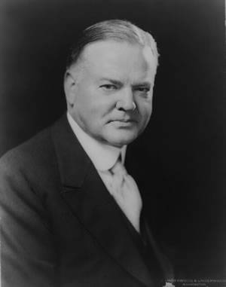
31st - Herbert Hoover 1929-1933
Born in Iowa in 1874
He held more press conferences than any other President.
He donated all his paychecks to charity.
He decreased the working day from 12 hours to 8 hours.
The Stock Market crashed and America entered the Great Depression during his term in Office.

Slide 33
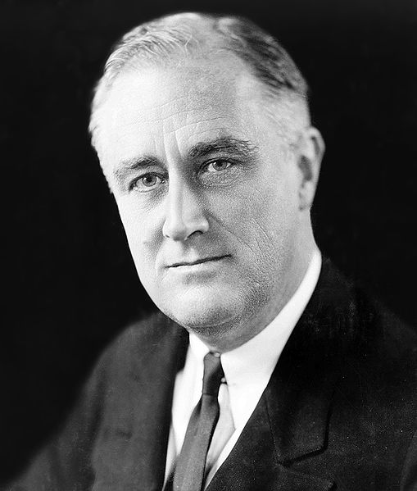
32nd – Franklin D. Roosevelt 1933-1945
Born in New York in 1882
He had the longest Presidential term in office, 12 years (3 terms)
He is the only President to be in a wheelchair.
He is on the dime.
His cousin was Teddy Roosevelt.
He was the 1st President to appear on television.

Slide 34
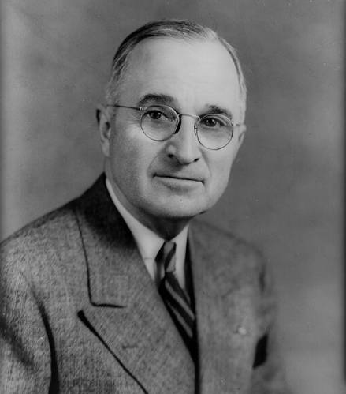
33rd – Harry S Truman 1945-1953
Born in Missouri in 1884
He loved to read and play the piano.
He had 9 clocks in his office at one time.
The initial “S” in his middle name doesn’t stand for anything.

Slide 35
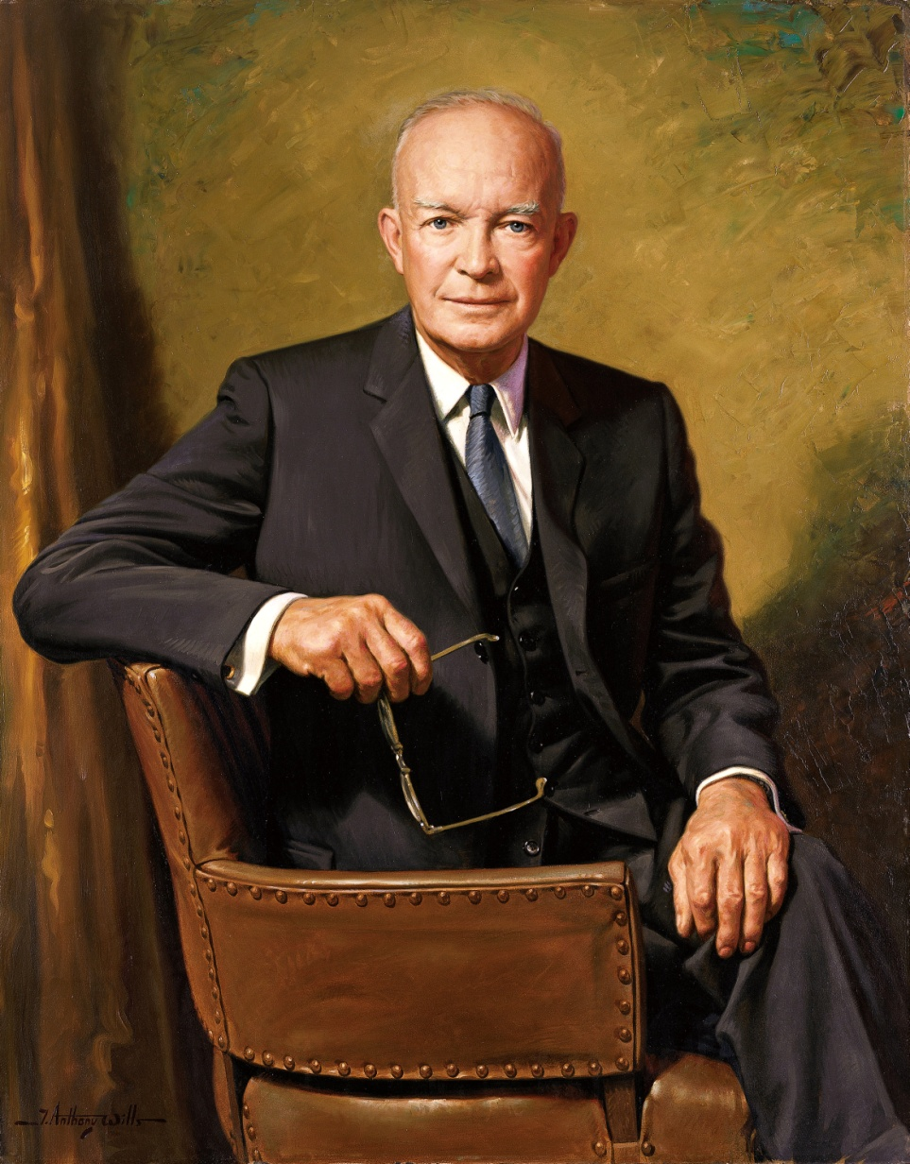
34th - Dwight D. Eisenhower 1953-1961
Born in Texas in 1890
He served in World War I and II.
He launched the Interstate Highway System.
He is on the silver dollar.

Slide 36
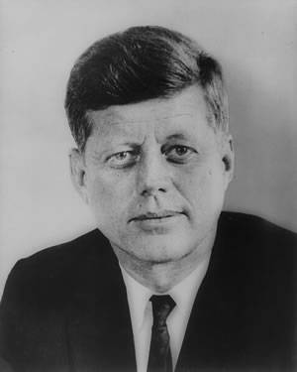
35th - John F. Kennedy 1961-1963
Born in Massachusetts in 1917
He is the youngest president voted in Office.
He is on the 50 cent piece.
He was assassinated on a trip in Dallas, Texas.
He declined his salary as President because he was so wealthy.

Slide 37
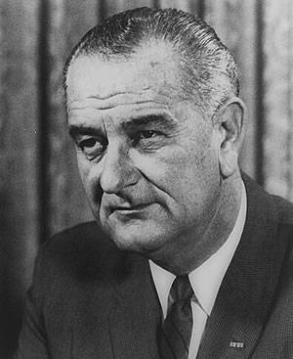
36th - Lyndon B. Johnson 1963-1969
Born in Texas in 1908
He was Vice President for John Kennedy and took Office when he died.
He would belch loudly whenever he felt like it.
He loved talking on the phone so much that he had them installed everywhere in the White House, even in the bathroom!

Slide 38
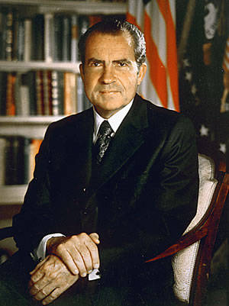
37th - Richard Nixon 1969-1974
Born in California in 1913
He was the 1st President to visit all 50 states.
He resigned during his 2nd term in office for the Watergate Scandal.
He was President when the 1st man landed on the moon.
He called all American soldiers home from the Vietnam War.

Slide 39
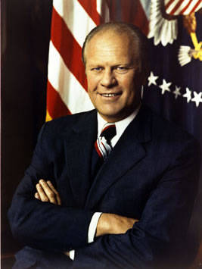
38th - Gerald R. Ford 1974-1977
Born in Nebraska in 1913
He was Vice President for Nixon and took over when Nixon resigned.
He was the most athletic President.

Slide 40
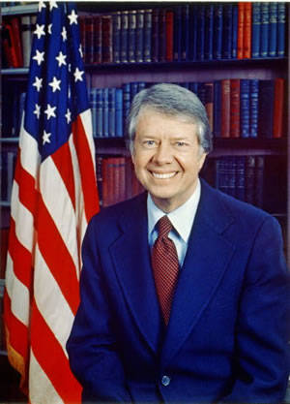
39th - James E. Carter 1977-1981
Born in Georgia in 1924
He owned a peanut farm.
He was the 1st President born in a hospital.

Slide 41
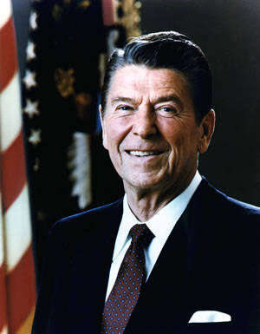
40th – Ronald Regan 1981-1989
Born in Illinois in 1911
He was a movie actor before he became President.
He is the oldest President elected.
He loved jelly beans.

Slide 42
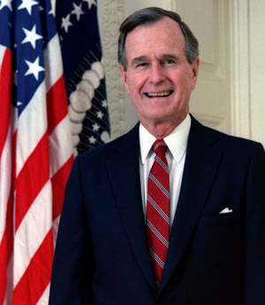
41st - George H. W. Bush 1989-1993
Born in Massachusetts in 1924
He was Vice President for Regan.
He is a very rich oil man.
He became a Navy pilot at age 19.
His son, George W. Bush was the 43rd President.

Slide 43
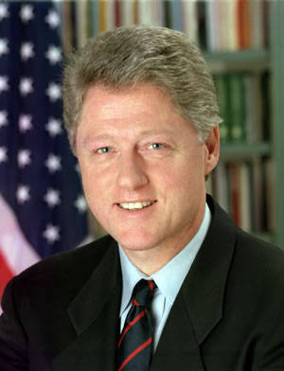
42nd – William Clinton 1993-2001
Born in Arkansas in 1946
He is the 2nd President to be impeached.
He was well liked by the People and rated highly in public opinion polls.

Slide 44
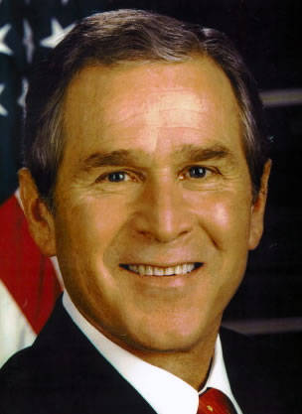
43rd – George W. Bush 2001-2009
Born in Connecticut in 1946
His father was the 41st President.
He was President when terrorist attacked U.S. on September 11th, 2001.

Slide 45
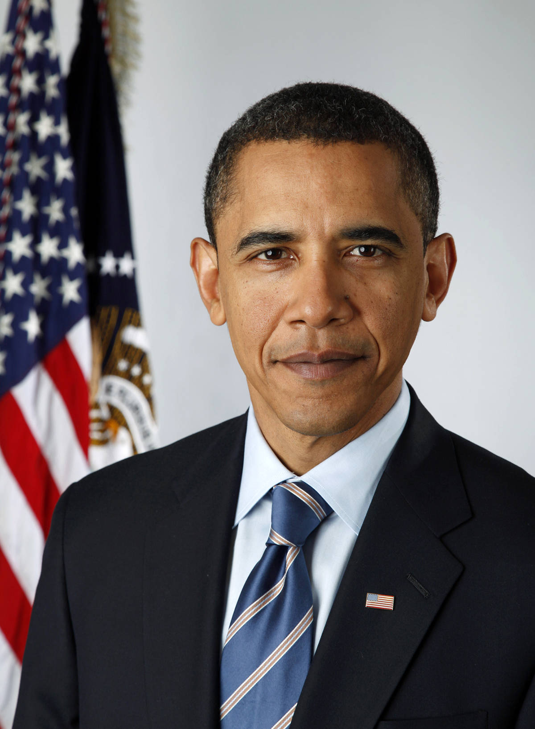
44th - Barack Obama 2009-2017
Born in Hawaii in 1961
1st African American to become President.
His inauguration was the largest attended presidential ceremony with an estimated crowd of nearly 2 million people.
He loves to write and is the author of 2 books.
He loves to read comic books.

Slide 46
45th - ? 2017

Slide 47
References
Wikipedia
Pictures by www.whitehouse.gov
“Lives of the Presidents” by Kathleen Krull

